Slide 1
Compare Instructions
© 2015 John Sefcovic

Slide 2
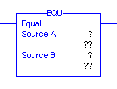
Compare
Equal To
The EQU input instruction compares two values Source A to Source B. If the values are equal, it allows rung continuity. Source A and Source B can either tags that contain values or be constant values, however Source A and Source B cannot both be constants.

Slide 3
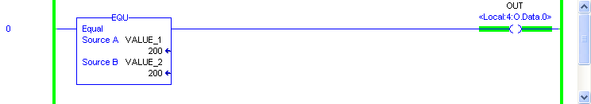
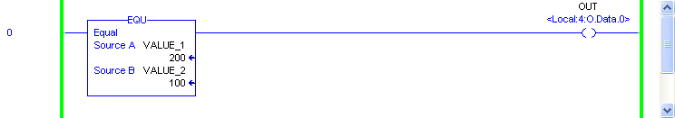
Equal To

Slide 4
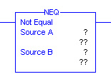
Not Equal
The NEQ input instruction compares two values to not be equal. If Source A and Source B are not equal, the instruction is logically true. If the two values are equal, the instruction is logically false. Source A and Source B can either be tags that contain values or be constant values, however Source A and Source B cannot both be constants.

Slide 5

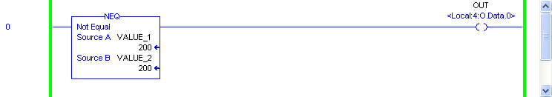
Not Equal

Slide 6
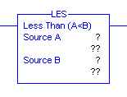
Less Than
The LES input instruction compares if Source A is less than Source B for the instruction to be logically true. Source A and Source B can be either tags that contain values or be constant values, however Source A and Source B cannot both be constants.

Slide 7
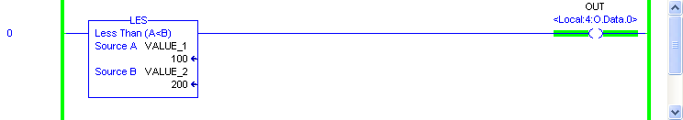
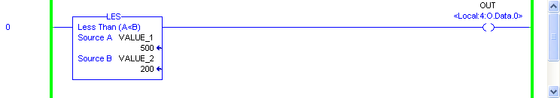
Less Than

Slide 8
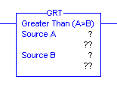
Greater Than
The GEQ input instruction compares if Source A is greater than Source B for the instruction to be logically true. Source A and Source B can either be tags that contain values or be constant values, however Source A and Source B cannot both be constants.

Slide 9
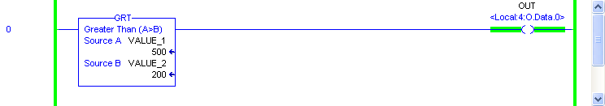
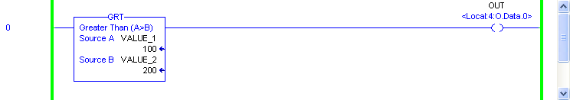
Greater Than

Slide 10
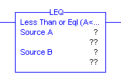
Less Than Or Equal
The LEQ input instruction compares if Source A is less than or equal to Source B for the instruction to be logically true. Source A and Source B can be either tags that contain values or be constant values, however Source A and Source B cannot both be constants.

Slide 11
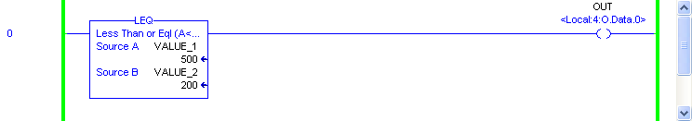
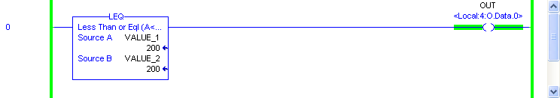

Less Than Or Equal

Slide 12
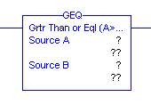
Greater Than Or Equal
The GEQ input instruction compares if Source A is greater than or equal to Source B for the instruction to be logically true. Source A and Source B can either be tags that contain values or be constant values, however Source A and Source B cannot both be constants.

Slide 13
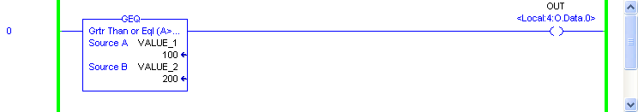
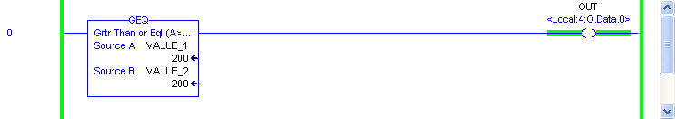

Greater Than Or Equal

Slide 14
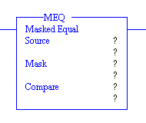
Masked Equal
The MEQ conditional input instruction compares the bit data of a Source tag data value at a Compare reference tag value through a Mask. If the values match, the instruction is true. This instruction allows portions of the data to be masked by a separate word. Source, or Mask, or Compare can either be tags that contain values or be constant values, however the Source and Compare cannot both be constants.

Slide 15
Masked Equal
SOURCE
MASK
0 = ignore
1 = recognize
COMPARE
The bits with a 0 mask will be ignored and not part of the comparison.
The bits with a 1 Mask are not equal between the Source and Compare making the instruction false.

Slide 16
Masked Equal
SOURCE A
MASK
0 = ignore
1 = recognize
COMPARE
The bits with a 0 mask will be ignored and not part of the comparison.
The bit with a 1 Mask are equal between the Source and Compare making the instruction true.

Slide 17
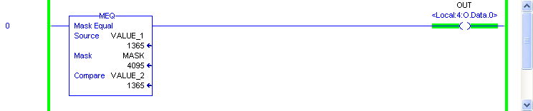
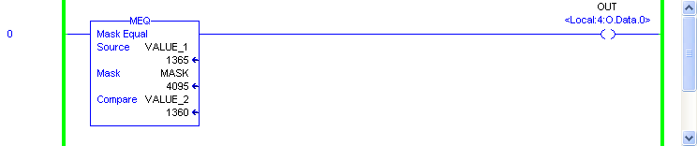
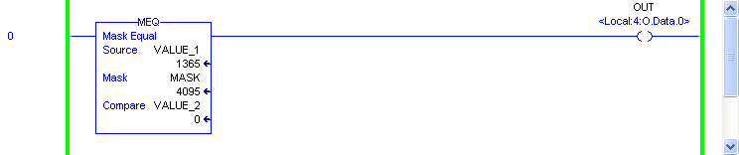
Masked Equal
Any bit values “masked out” would be ignored if present.
Simplified to show the bit values “masked in” must be the same.

Slide 18
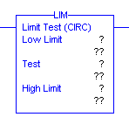
Limit Test
The LIM conditional input instruction tests for values to be within or outside a specified range, depending on how the limits are set. The Test is compared to the Low Limit and High Limit to determine if the instruction is logically true. The Low Limit or High Limit can either be tags that contain values or be constant values, however the Test cannot be a constant, it must be a tag.

Slide 19
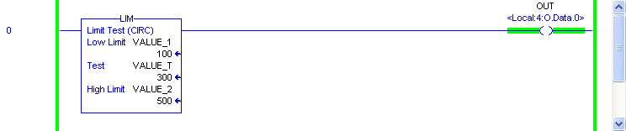
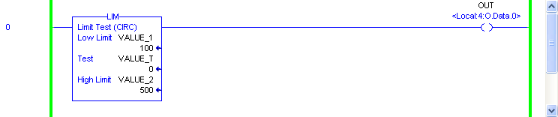
Limit Test – Within Limits
The Low Limit value is less than…
… the High Limit value.
Test
Low Lim
High Lim
n
number line
n + 1

Slide 20
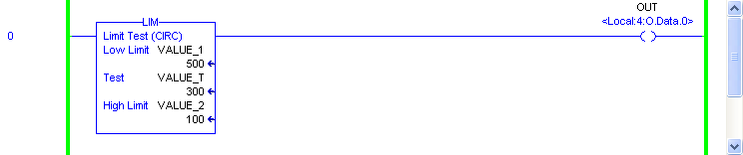

Limit Test – Outside Limits
The Low Limit value is greater than…
… the High Limit value.
Test
High Lim
Low Lim
n
number line
n + 1

Slide 21

Compare
The CMP instruction performs a comparison on the specified in the expression. An expression consists of tags and/or constant values separated by comparison operators. Parentheses ( ) can be used to define sections of more complex expressions.

Slide 22


Compare

Slide 23

The Compare instruction buttons are in he Compare Tab.

Slide 24
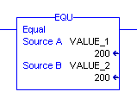
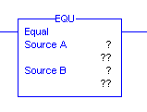
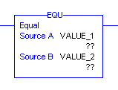
When the instruction is first entered, there are two sets of question marks.
Two of the question marks are for the tags.
When the rung is verified, the current value at the tags are shown.
The values may be entered in the instruction or the RSLogix 5000 Tag Editors.

